Slide 1

Capstone 1: EporiUm’s Sales Performance in Connecticut
By: Mequil Griffin Jr. – Year Up United Software Data Analytics

Slide 2
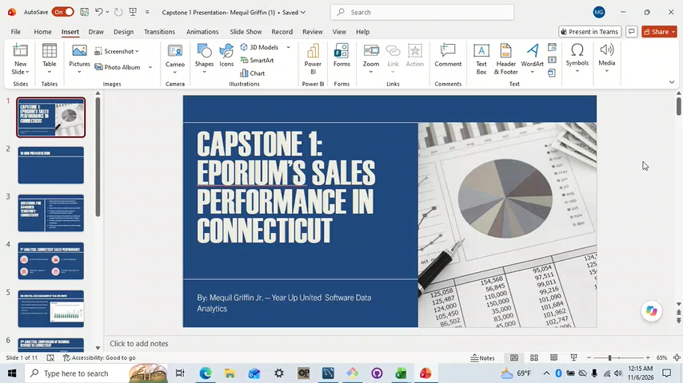
10 Min presentation

Slide 3
Questions for Assigned Territory: Connecticut
What is the total revenue overall for sales in Connecticut? Include the start and end date of sales.
What is the revenue breakdown by year and month?
Provide a comparison for total revenue for Connecticut and its respective region?
What is the number of transactions per month and average transaction amount by product category?
Provide a ranking of in-stores sales performance in Connecticut.
What is your recommendation for our focus leading into 2026?

Slide 4
1st Analysis: Connecticut sales performance
$2,392,222 Total Revenue
31, 039 Transactions
Start Date: January 1st, 2022
End Date: December 31st, 2025

Slide 5
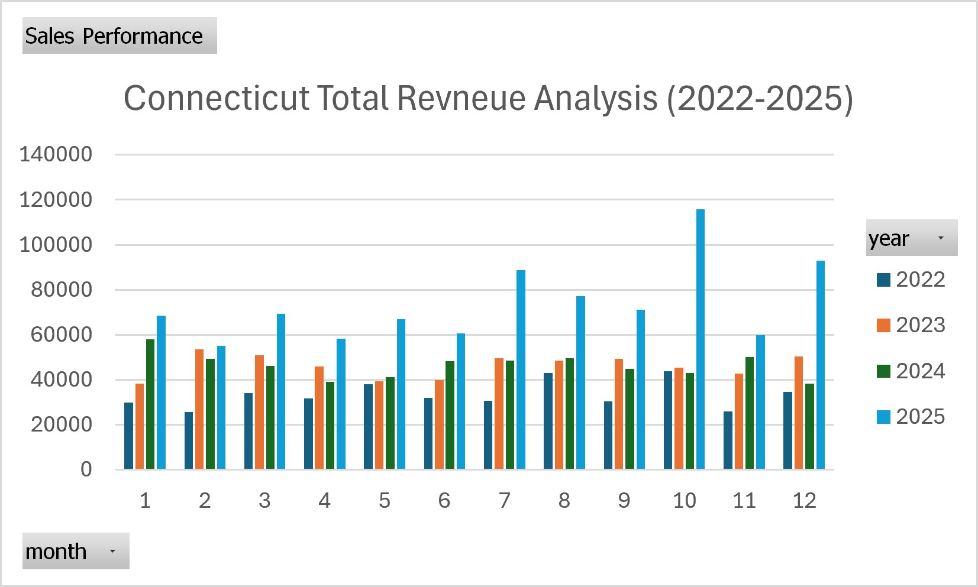
2nd Analysis: Sales breakdown by year and month
2025 had the most sales every month
2022 had the least sales every month
Trend shows gradual improvement per year
Small drop in sales during year 2024

Slide 6
3rd Analysis: Comparison of Regional Revenue vs Connecticut
Connecticut makes up for 35% of East Region revenue

Slide 7
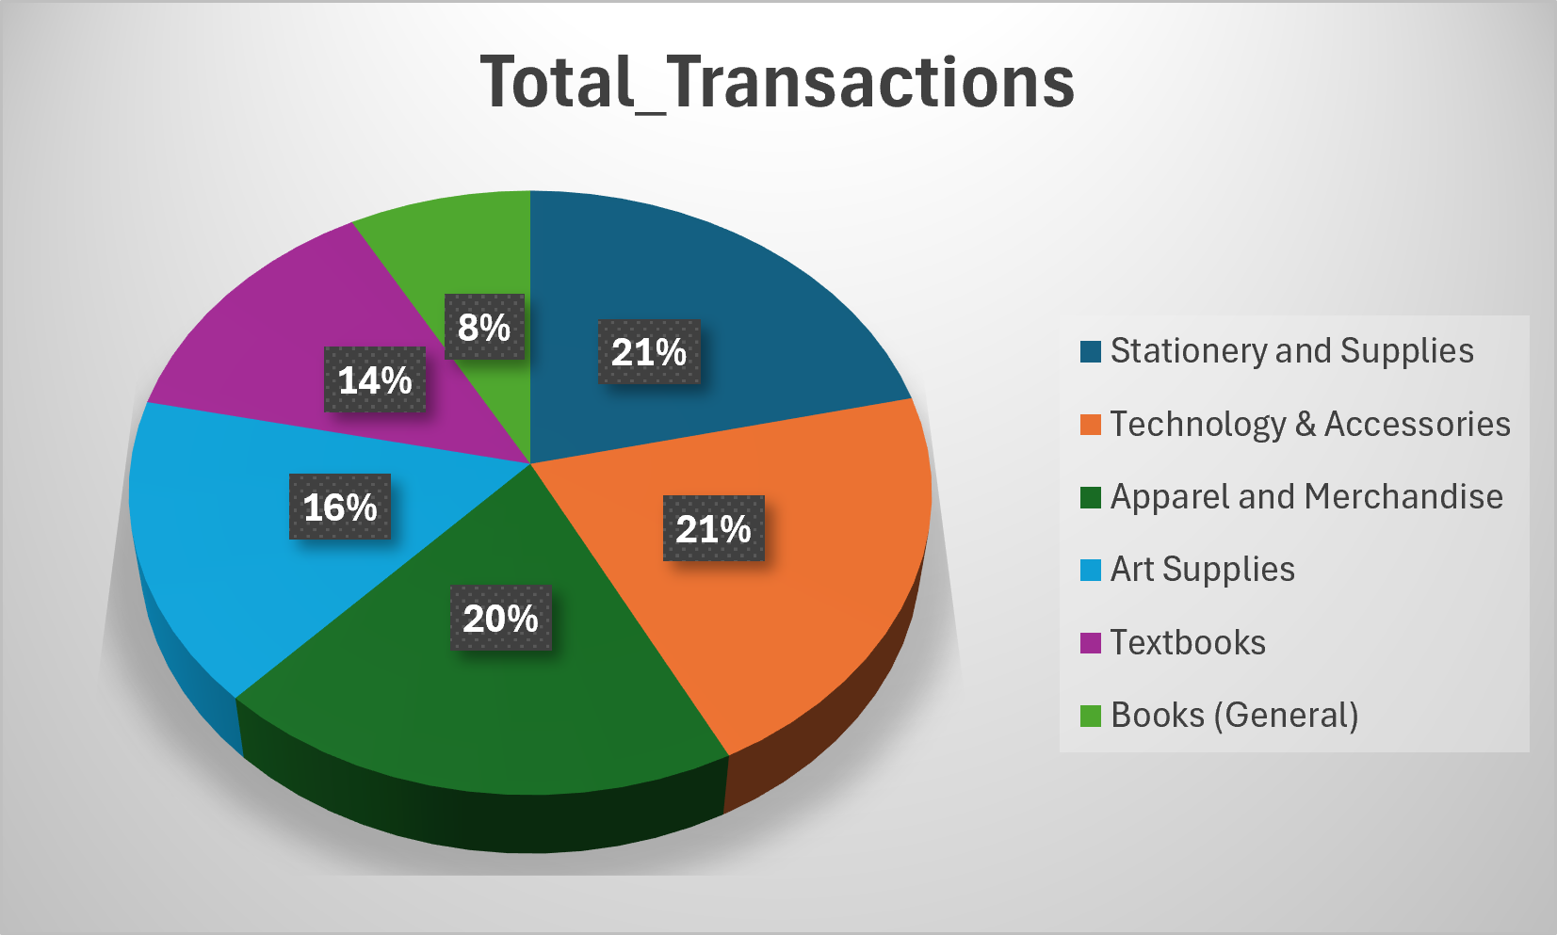
4th Analysis: Transactions per month and average transactions by product category
Stationery and Supplies had the most transactions with 3719.
Technology & Accessories had the highest average sales with $466.

Slide 8
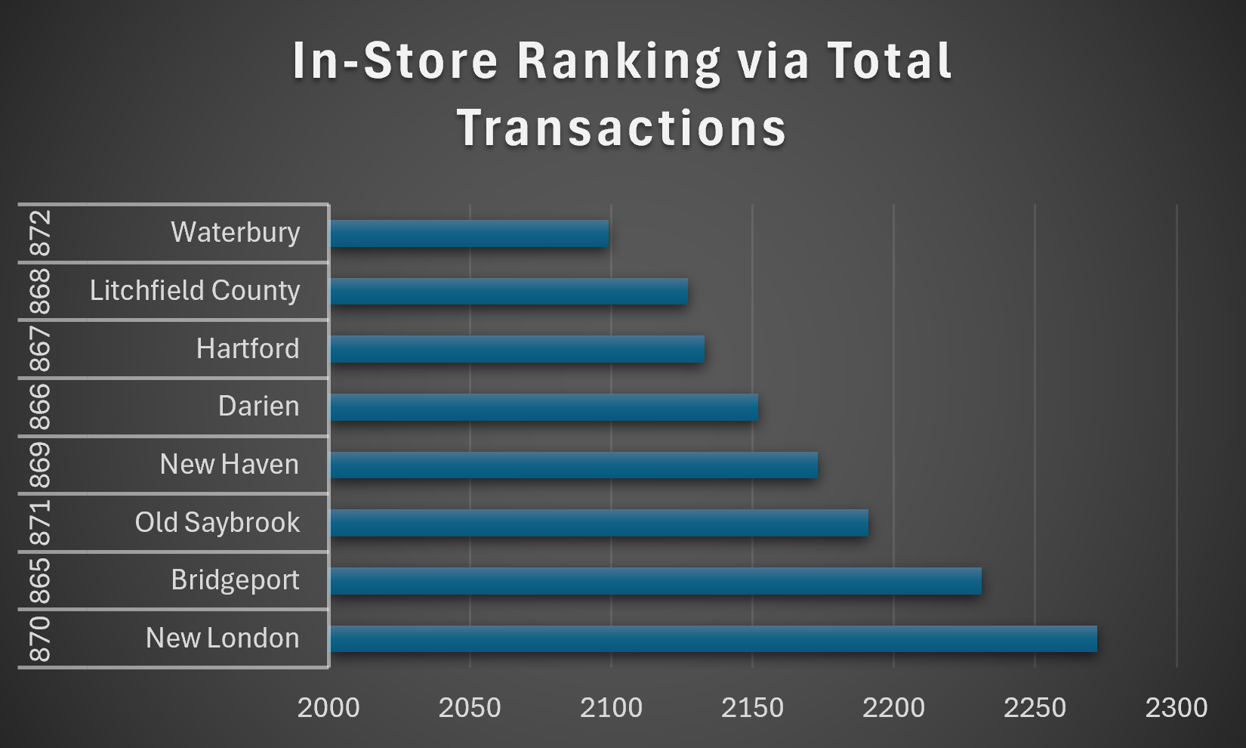
5th Analysis: Ranking of in-store sales performance for Connecticut
Highest Store Transactions: New London with 2722
Lowest Store Transactions: Waterbury with 2099

Slide 9

6th Analysis: Sales performance focus leading into 2026
Mainly focus on both Stationery & Supplies and Technology & Accessories.
Improving sales in these categories could lead to more sales, especially in Waterbury.
Introduce sales and promotions for our lacking categories such as Books.

Slide 10
Key Takeaways
Connecticut is a third of the East Region Revenue
The best-selling product categories are Technology & Accessories and Stationery & Supplies
New London is Connecticut’s best store
Waterbury could use improvements through promotions and sales
Most importantly: Connecticut sales have been moving up consistently EVERY year

Slide 11
Thank you

